Slide 1
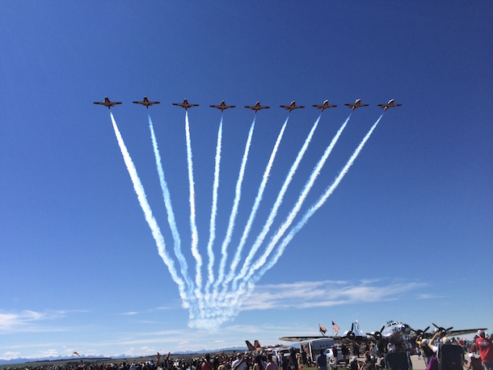
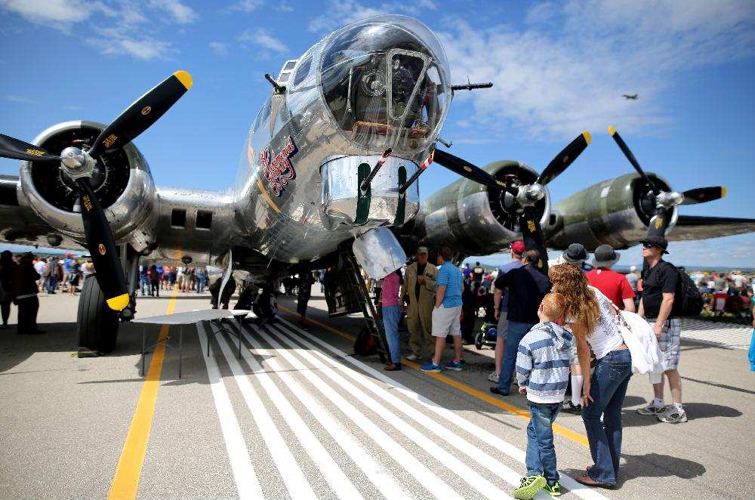
SPRINGBANK AIRPORT COMMUNITY NOISE CONSULTATIVE COMMITTEE May 30, 2017

Slide 2
Welcome & Introductions

Slide 3
Agenda
Airport statistics and metrics
Committee Terms of Reference
Wings Over Springbank Airshow 2017
Harmony Representative on Committee
Fixed bi-annual meeting dates
New Business

Slide 4
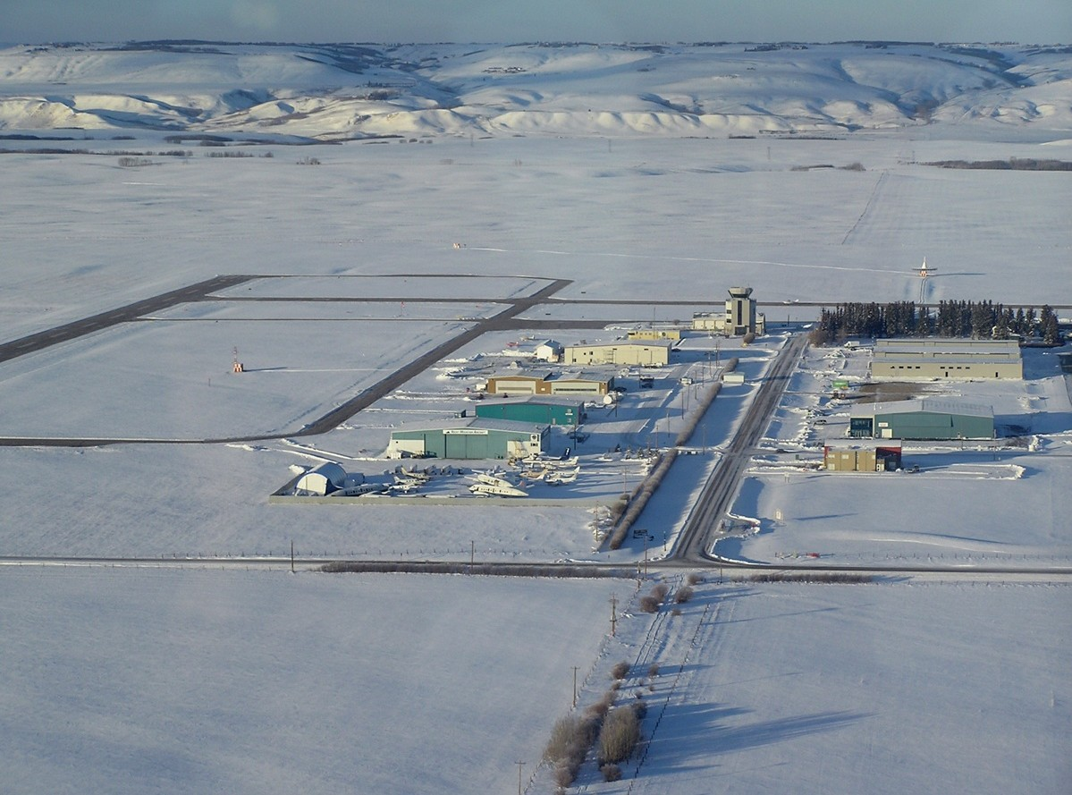
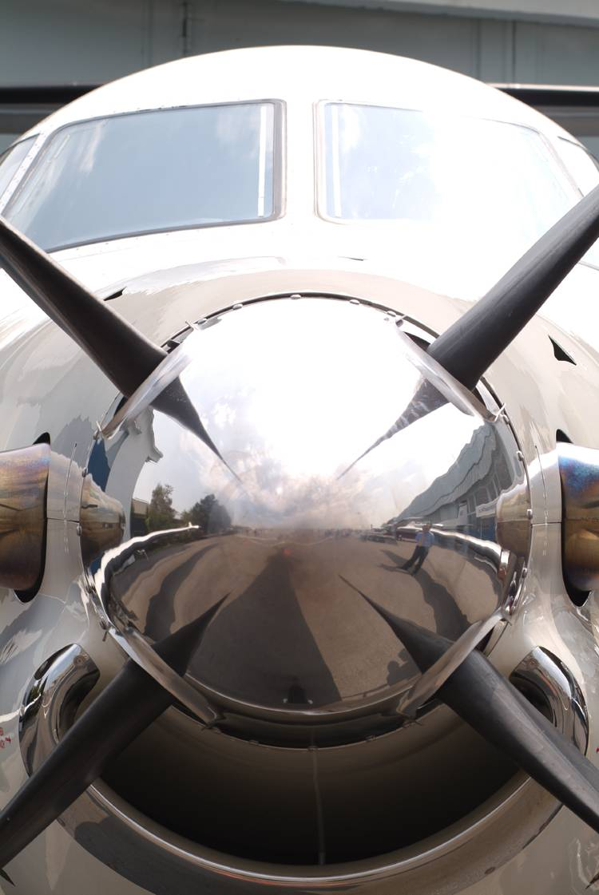
Operational Information

Slide 5
Annual Aircraft Movements

Slide 6
Monthly Aircraft Movements
Monthly Aircraft Movements slide indicates where peak months are, and in the case of YBW can be directly attributed to weather. What can be seen for 2016 is that generally the trend is an increase in total movements.

Slide 7
Jet Night Traffic

Slide 8
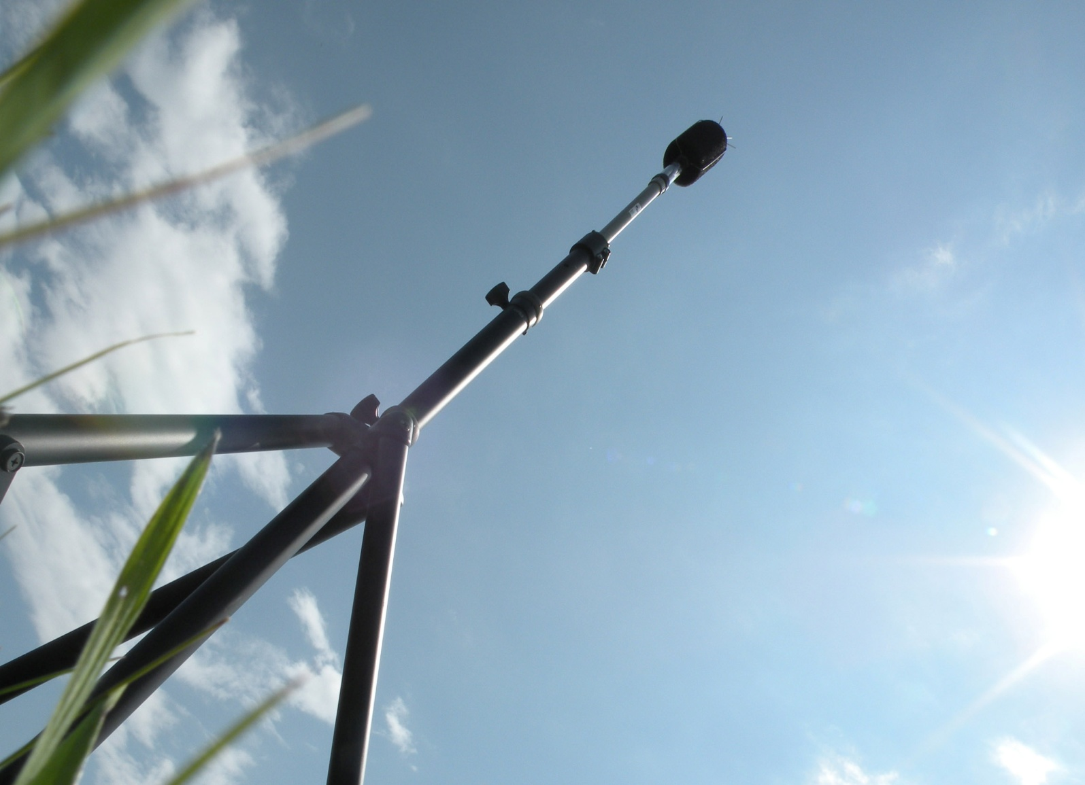
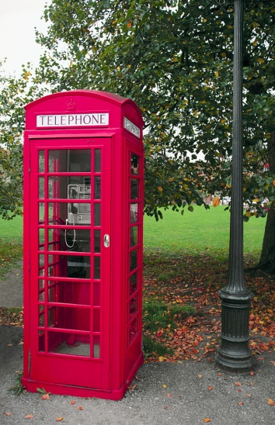
Noise Concern Information

Slide 9
Runway Usage

Slide 10
Monthly Noise Concerns

Slide 11
Day & Night Concerns

Slide 12
Hourly Noise Concerns

Slide 13
Concerns by Operation

Slide 14
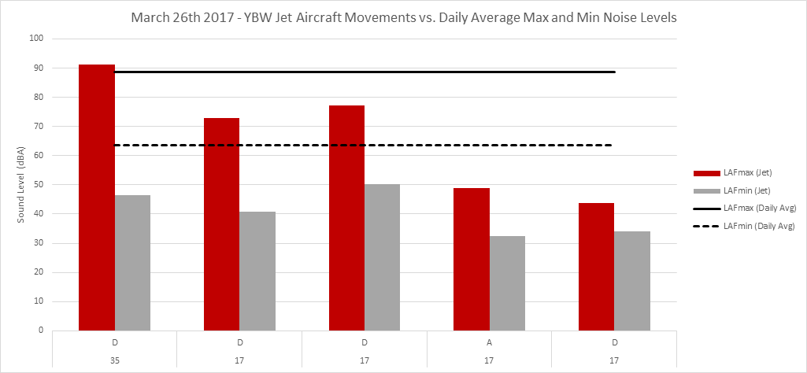
Noise Monitoring
Measured noise from Jet aircraft
The max noise level from a jet is below (or just above in one instance) the average max noise level from all aircraft that day.

Slide 15
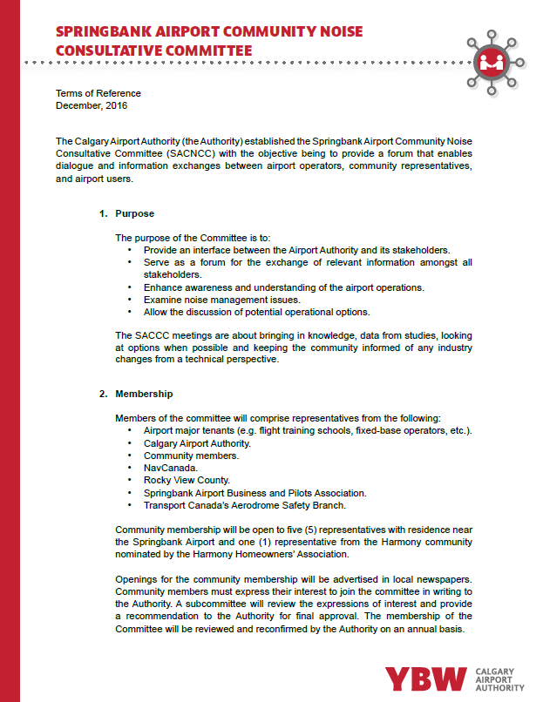
Committee Terms of Reference
Purpose
Membership
5 Springbank residents
1 Harmony resident
Regular meeting schedule
May
November

Slide 16
Wings Over Springbank
Event to take place July 29 and 30 from 10 am to 6 pm
Practice day July 28

Slide 17
Harmony Representative
Representatives nominated by the Harmony Homeowners’ Association;
YBW to review expressions of interest and make decision;
Representative to join for the November 2017 SACNCC meeting.

Slide 18
Bi-annual Meetings
Next meeting: third week of November
2018 meeting schedule to be approved at next SACNCC meeting

Slide 19
Questions??

